Slide 1
COMP 4500
Week 11 - Wednesday

Slide 2
Last time
What did we talk about last time?
Reductions via gadgets
Efficient certification

Slide 3
Questions?

Slide 4
Assignment 6

Slide 5
Logical warmup
Ten people are marooned on a deserted island
They gather many coconuts and put them all in a community pile
They are so tired that they decide to divide them into ten equal piles the next morning
One castaway wakes up hungry and decides to take his share early
After dividing up the coconuts, he finds he is one coconut short of ten equal piles
He notices a monkey holding one coconut
He tries to take the monkey's coconut so that the total is evenly divisible by 10
However, when he tries to take it, the monkey hits him on the head with it, killing him
Later, another castaway wakes up hungry and also decides to take his share early
On the way to the coconuts he finds the body of the first castaway and realizes that he is now be entitled to 1/9 of the total pile
After dividing them up into nine piles he is again one coconut short of an even division and tries to take the monkey's (slightly) bloody coconut
Again, the monkey hits the second man on the head and kills him
Each of the remaining castaways goes through the same process, until the 10th person to wake up realizes that the entire pile for himself
What is the smallest number of coconuts in the original pile (ignoring the monkey's)?

Slide 6
Three-sentence Summary of Proving Problems NP-Complete

Slide 7
Proving Problems are NP-Complete

Slide 8
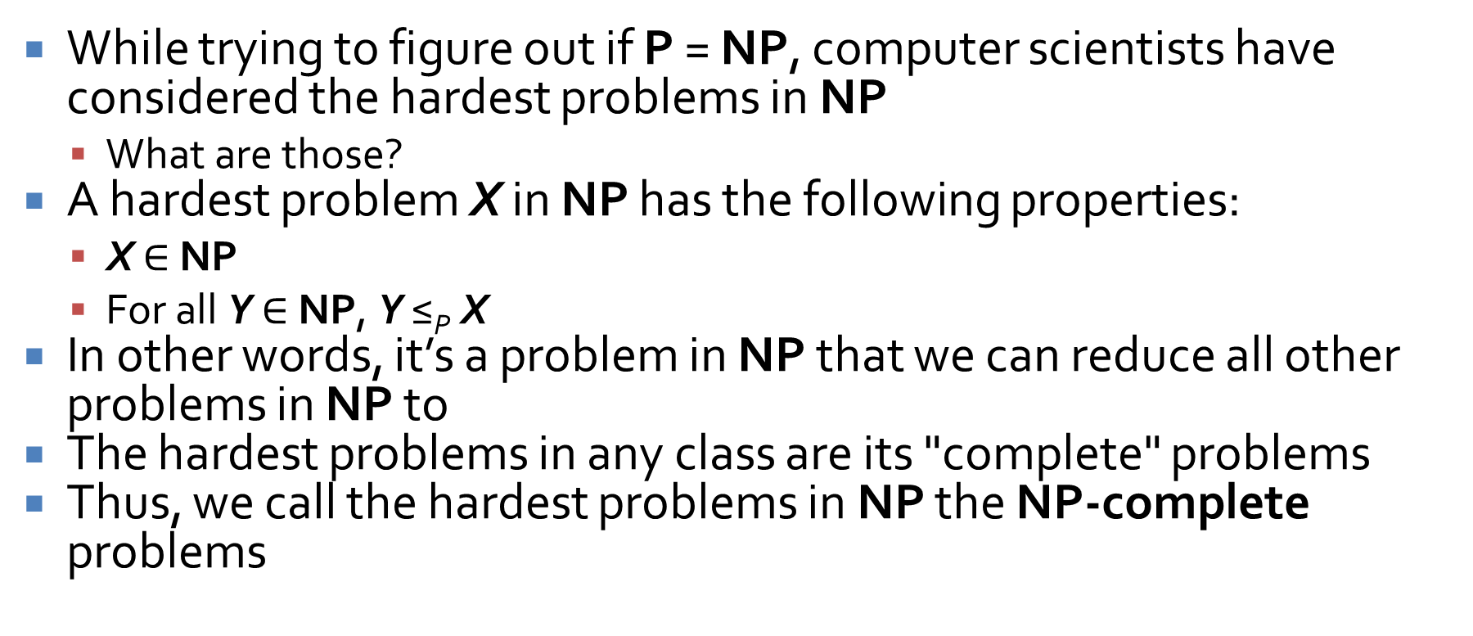
NP-complete problems
While trying to figure out if P = NP, computer scientists have considered the hardest problems in NP
  What are those?
A hardest problem X in NP has the following properties:
  X $∈$ NP
  For all Y $∈$ NP, Y ≤_{P} X
In other words, it’s a problem in NP that we can reduce all other problems in NP to
The hardest problems in any class are its "complete" problems
Thus, we call the hardest problems in NP the NP-complete problems

Slide 9
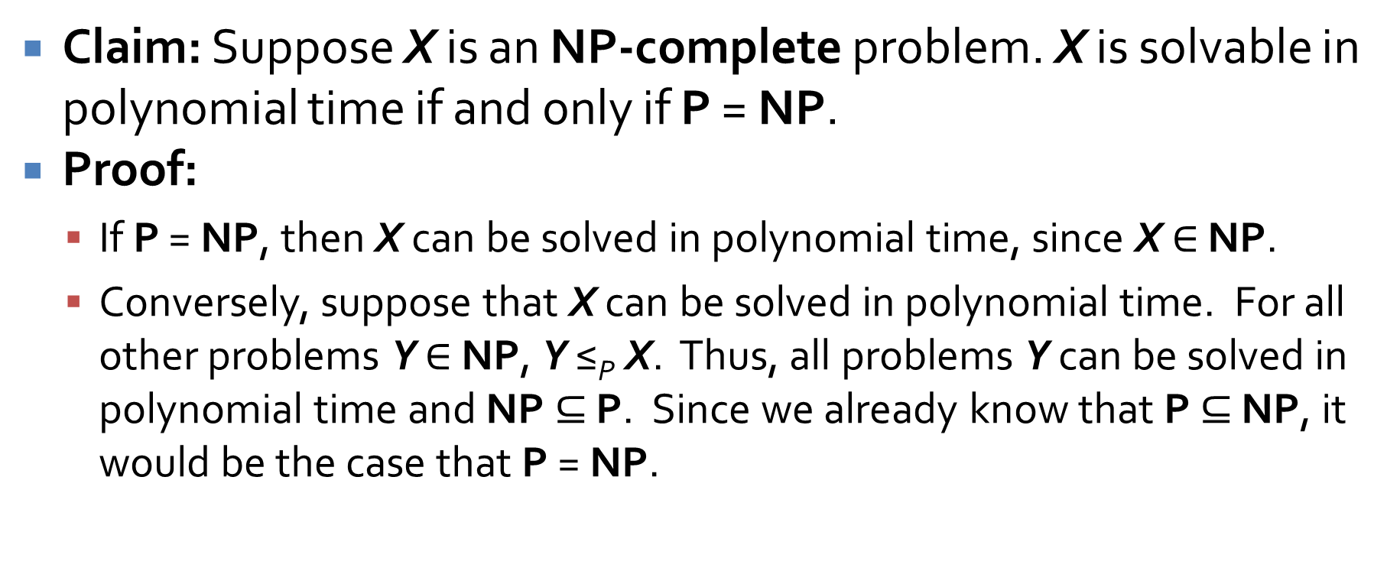
An important consequence
Claim: Suppose X is an NP-complete problem. X is solvable in polynomial time if and only if P = NP.
Proof:
  If P = NP, then X can be solved in polynomial time, since X $∈$ NP.
  Conversely, suppose that X can be solved in polynomial time. For all other problems Y $∈$ NP, Y ≤_{P} X. Thus, all problems Y can be solved in polynomial time and NP $⊆$ P. Since we already know that P $⊆$ NP, it would be the case that P = NP.

Slide 10
Why does NP-complete even exist?
It might seem strange that there's a layer of problems that are all the "hardest" in NP
Wouldn't it be possible for there to be lots of problems in NP that can't be reduced to each other?
Thus, we could imagine lots of incomparable problems floating around, none of which are clearly harder than the others
Or, there could be infinite problems in NP, with each one strictly harder than the previous!

Slide 11
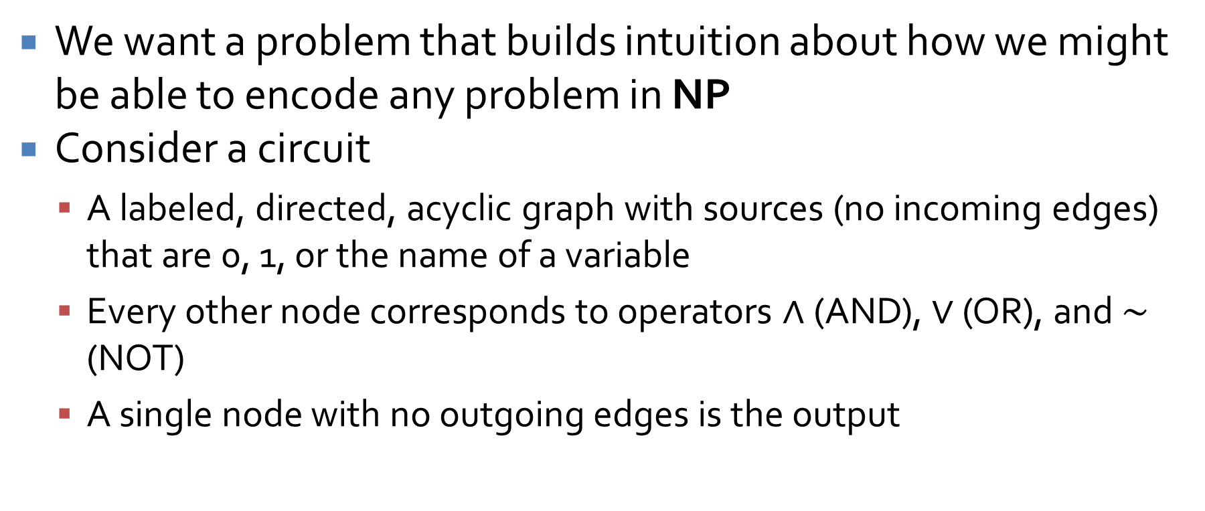
Circuit
We want a problem that builds intuition about how we might be able to encode any problem in NP
Consider a circuit
  A labeled, directed, acyclic graph with sources (no incoming edges) that are 0, 1, or the name of a variable
  Every other node corresponds to operators $∧$(AND), $∨$ (OR), and $∼$ (NOT)
  A single node with no outgoing edges is the output

Slide 12
Circuit satisfiability
The circuit satisfiability problem takes such a circuit as input and asks if there is an assignment of values to inputs that causes the output to be 1
  If there is, the circuit is satisfiable
  A satisfying assignment is one that results in this output of 1
Circuit satisfiability is NP-complete because we can reduce any problem in NP to it

Slide 13
How can we reduce anything in NP to circuit satisfiability?
Any algorithm that takes a fixed number n of bits as input and produces a "yes" or "no" answer can be represented by this kind of circuit
The circuit is the same as an algorithm because its output is 1 on precisely the inputs for which the algorithm outputs "yes"
If the algorithm takes a number of steps that is polynomial in n, the circuit must have polynomial size
The Cook-Levin theorem goes into careful detail about how to construct such a circuit from an algorithm

Slide 14
3-Satisfiability is NP-complete
Proof:
  3-SAT is in NP since we can verify in polynomial time that a truth assignment satisfies a given set of clauses.
  By reducing circuit satisfiability to 3-SAT, we will thus prove that 3-SAT is NP-complete.
  Turn any circuit into an equivalent instance of SAT with at most 3 variables per clause
  Turn any instance of SAT where each clause has at most 3 variables into an equivalent instance with exactly 3 variables

Slide 15
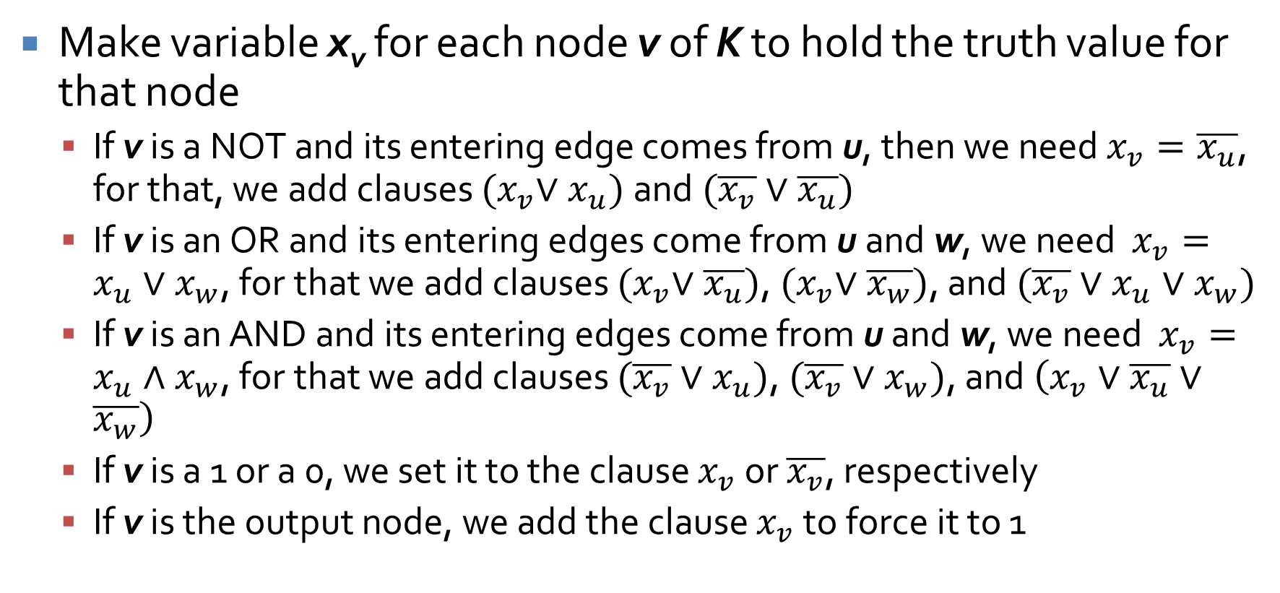
Step 1: Convert circuit K to SAT
Make variable x_{v} for each node v of K to hold the truth value for that node
  If v is a NOT and its entering edge comes from u, then we need $x_{v}=\overline{x_{u}}$, for that, we add clauses ${(x}_{v}∨x_{u})$ and$(\overline{x_{v}}∨\overline{x_{u}})$
  If v is an OR and its entering edges come from u and w, we need $x_{v}=x_{u}{∨x}_{w}$, for that we add clauses ${(x}_{v}∨\overline{x_{u}})$, ${(x}_{v}∨\overline{x_{w}})$, and $(\overline{x_{v}}∨x_{u}∨x_{w})$
  If v is an AND and its entering edges come from u and w, we need $x_{v}=x_{u}{∧x}_{w}$, for that we add clauses $(\overline{x_{v}}∨x_{u})$, $(\overline{x_{v}}∨x_{w})$, and $\left(x_{v}∨\overline{x_{u}}∨\overline{x_{w}}\right)$
  If v is a 1 or a 0, we set it to the clause $x_{v}$ or $\overline{x_{v}}$, respectively
  If v is the output node, we add the clause $x_{v}$ to force it to 1

Slide 16
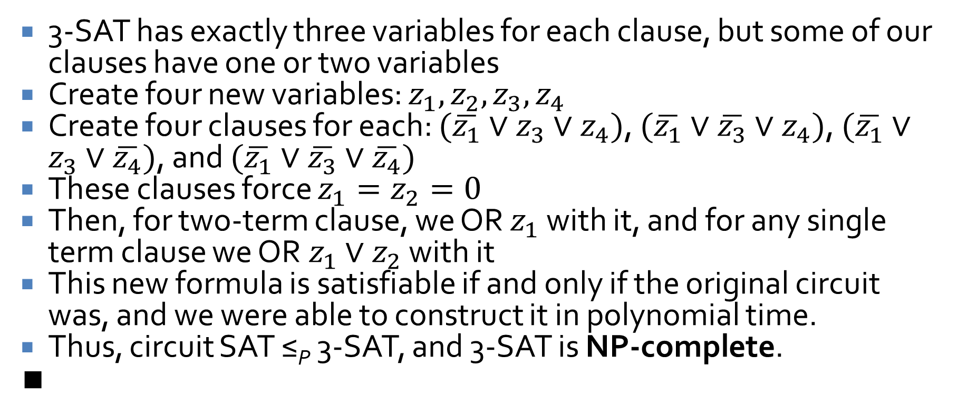
Step 2: Converting the SAT to 3-SAT
3-SAT has exactly three variables for each clause, but some of our clauses have one or two variables
Create four new variables: $z_{1},z_{2},z_{3},z_{4}$
Create four clauses for each: $(\overline{z_{1}}∨z_{3}∨z_{4})$, $(\overline{z_{1}}∨\overline{z_{3}}∨z_{4})$, $(\overline{z_{1}}∨z_{3}∨\overline{z_{4}})$, and $(\overline{z_{1}}∨\overline{z_{3}}∨\overline{z_{4}})$
These clauses force $z_{1}=z_{2}=0$
Then, for two-term clause, we OR $z_{1}$ with it, and for any single term clause we OR$z_{1}∨z_{2}$ with it
This new formula is satisfiable if and only if the original circuit was, and we were able to construct it in polynomial time.
Thus, circuit SAT ≤_{P} 3-SAT, and 3-SAT is NP-complete.
∎

Slide 17
We get a bunch for free!
Earlier, we showed:
  3-SAT ≤_{P} independent set ≤_{P} vertex cover ≤_{P} set cover
By the transitivity of polynomial-time reduction, circuit SAT is reducible to all of these problems
Thus, all of these problems are NP-complete

Slide 18
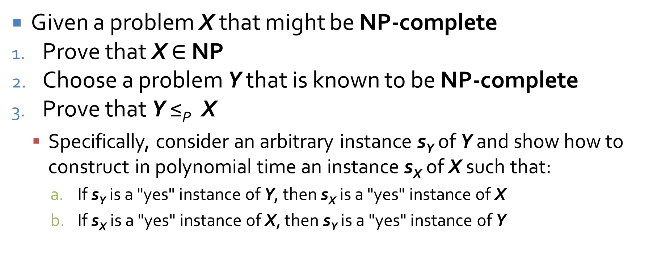
Strategy for proving problems NP-complete
Given a problem X that might be NP-complete
Prove that X $∈$ NP
Choose a problem Y that is known to be NP-complete
Prove that Y ≤_{P} X
  Specifically, consider an arbitrary instance s_{Y} of Y and show how to construct in polynomial time an instance s_{X} of X such that:
    If s_{Y} is a "yes" instance of Y, then s_{X} is a "yes" instance of X
    If s_{X} is a "yes" instance of X, then s_{Y} is a "yes" instance of Y

Slide 19
Review

Slide 20
Dynamic Programming

Slide 21
Weighted interval scheduling
The weighted interval scheduling problem extends interval scheduling by attaching a weight (usually a real number) to each request
Now the goal is not to maximize the number of requests served but the total weight
Our greedy approach is worthless, since some high value requests might be tossed out
We could try all possible subsets of requests, but there are exponential of those
Dynamic programming will allow us to save parts of optimal answers and combine them efficiently

Slide 22
Notation
We have n requests labeled 1, 2,…, n
Request i has a start time s_{i} and a finish time f_{i}
Request i has a value v_{i}
Two intervals are compatible if they don't overlap

Slide 23
Designing the algorithm
Let's go back to our intuition from the unweighted problem
Imagine that the requests are sorted by finish time so that f₁ ≤ f₂ ≤ … ≤ f_{n}
We say that request i comes before request j if i < j, giving a natural left-to-right order
For any request j, let p(j) be the largest index i < j such that request i ends before j begins
  If there is no such request, then p(j) = 0

Slide 24
p(j) examples
Index
1
2
3
4
5
6
2
p(1) = 0
p(2) = 0
p(3) = 1
p(4) = 0
p(5) = 3
p(6) = 3
4
4
7
2
1

Slide 25
Iterative solution to find value of weighted interval scheduling
Iterative-Compute-Opt
  M[0] = 0
  For j = 1 up to n
    M[j] = max(v_{j} + M[p(j)], M[j – 1])
Algorithm is O(n)

Slide 26
Algorithm for solution
Find-Solution(j, M)
  If j = 0 then
    Output nothing
  Else if v_{j} + M[p(j)] ≥ M[j – 1] then
    Output j together with the result of Find-Solution(p(j))
  Else
    Output the result of Find-Solution(j – 1)
Algorithm is O(n)

Slide 27
Why is this dynamic programming?
The key element that separates dynamic programming from divide-and-conquer is that you have to keep the answers to subproblems around
It's not simply a one-and-done situation
Based on which intervals overlap with which other intervals, it's hard to predict when you'll need an earlier M[j] value
Thus, dynamic programming can often give us polynomial algorithms but with linear (and sometimes even larger) space requirements

Slide 28
Informal guidelines
Weighted interval scheduling follows a set of informal guidelines that are essentially universal in dynamic programming solutions:
  There are only a polynomial number of subproblems
  The solution to the original problem can easily be computed from (or is one of) the solutions to the subproblems
  There is a natural ordering of subproblems from "smallest" to "largest"
  There is an easy-to-compute recurrence that lets us compute the solution to a subproblem from the solutions of smaller subproblems

Slide 29
Subset sum
Let's say that we have a series of n jobs that we can run on a single machine
Each job i takes time w_{i}
We must finish all jobs before time W
We want to keep the machine as busy as possible, working on jobs until as close to W as we can

Slide 30
A new recurrence
If job n is not in the optimal set, OPT(n, W) = OPT(n – 1, W)
If job n is in the optimal set, OPT(n, W) = w_{n} + OPT(n – 1, W – w_{n})
We can make the full recurrence for all possible weight values:
  If w < w_{i}, then OPT(i, w) = OPT(i – 1, w)
  Otherwise, OPT(i, w) = max(OPT(i – 1, w), w_{i} + OPT(i – 1, w – w_{i}))

Slide 31
Subset-Sum(n,W)
Create 2D array M[0…n][0…W]
For w from 1 to W
  Initialize M[0][w] = 0
For i from 1 to n
  For w from 0 to W
    If w < w_{i}, then
      OPT(i, w) = OPT(i – 1, w)
    Else
      OPT(i, w) = max(OPT(i – 1, w), w_{i} + OPT(i – 1, w – w_{i}))
Return M[n][W]

Slide 32
What does that look like?
We're building a big 2D array
Its size is nW
  n is the number of items
  W is the maximum weight
  Actually, it's got one more row and one more column, just to make things easier
The book makes this array with row 0 at the bottom
I've never seen anyone else do that
I'm going to put row 0 at the top

Slide 33
Table M of OPT values
0 | 0 | 0 | 0 | 0 | 0 | 0 | 0 | 0 | 0 | 0 | 0 | 0
1 | 0
2 | 0
 | 0
 | 0
 | 0
i – 1 | 0
i | 0
 | 0
 | 0
 | 0
n | 0
 | 0 | 1 | 2 |  | w- w_{i} |  | w |  |  |  |  | W

Slide 34
Running time
The algorithm has a simple nested loop
  The outer loop runs n + 1 times
  The inner loop runs W + 1 times
The total running time is O(nW)
The space needed is also O(nW)
Note that this time is not polynomial in terms of n
It's polynomial in n and W, but W is the maximum weight
  Which could be huge!
We call running times like this pseudo-polynomial
Things are fine if W is similar to n, but it could be huge!

Slide 35
Subset sum example
Weights: 1, 4, 8, 2, 10
Maximum: 15
Create the table to find all of the optimal values that include items 1, 2,…, i for every possible weight w up to 15

Slide 36
Table to fill in
i | w_{i} | 0 | 1 | 2 | 3 | 4 | 5 | 6 | 7 | 8 | 9 | 10 | 11 | 12 | 13 | 14 | 15
0 | 0 | 0 | 0 | 0 | 0 | 0 | 0 | 0 | 0 | 0 | 0 | 0 | 0 | 0 | 0 | 0 | 0
1 | 1
2 | 8
3 | 4
4 | 2
5 | 10

Slide 37
Knapsack
The knapsack problem is a classic problem that extends subset sum a little
As before, there is a maximum capacity W and each item has a weight w_{i}
Each item also has a value v_{i}
The goal is to maximize the value of objects collected without exceeding the capacity
…like Indiana Jones trying to put the most valuable objects from a tomb into his limited-capacity knapsack

Slide 38
An easy extension
The knapsack problem is really the same problem, except that we are concerned with maximum value instead of maximum weight
We need only to update the recurrence to keep the maximum value:
  If w < w_{i}, then OPT(i, w) = OPT(i – 1, w)
  Otherwise, OPT(i, w) = max(OPT(i – 1, w), v_{i} + OPT(i – 1, w – w_{i}))

Slide 39
Knapsack example
Items (w_{i}, v_{i}):
  (1, 15)
  (5, 10)
  (3, 9)
  (4, 5)
Maximum weight: 8
Create the table to find all of the optimal values that include items 1, 2,…, i for every possible weight w up to 8

Slide 40
Fill in the table
i | w_{i} | v_{i} | 0 | 1 | 2 | 3 | 4 | 5 | 6 | 7 | 8
0 | 0 | 0 | 0 | 0 | 0 | 0 | 0 | 0 | 0 | 0 | 0
1 | 1 | 15 | 0
2 | 5 | 10 | 0
3 | 3 | 9 | 0
4 | 4 | 5 | 0

Slide 41
Alignment
An alignment is a list of matches between characters in strings X and Y that doesn't cross
Consider:
  stop-
  -tops
This alignment is (2,1), (3,2), (4,3)

Slide 42
Alignment cost
Some optimal alignment will have the lowest cost
Cost:
  Gap penalty δ > 0, for every gap
  Mismatch cost α_{pq} for aligning p with q
    α_{pp} is presumably 0 but does not have to be
  Total cost is the sum of the gap penalties and mismatch costs

Slide 43
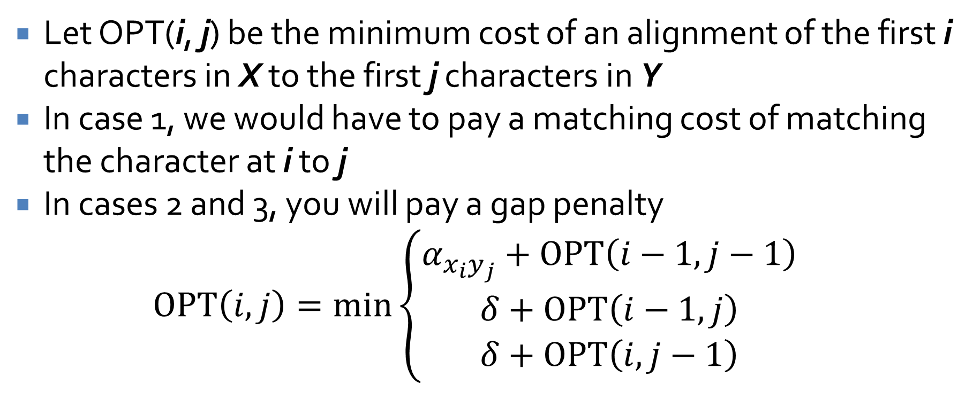
Formulating the recurrence
Let OPT(i, j) be the minimum cost of an alignment of the first i characters in X to the first j characters in Y
In case 1, we would have to pay a matching cost of matching the character at i to j
In cases 2 and 3, you will pay a gap penalty
$$OPT\left(i,j\right)=\min\left\{\begin{aligned}α_{x_{i}y_{j}}+OPT\left(i−1,j−1\right) \\ δ+OPT\left(i−1,j\right) \\ δ+OPT\left(i,j−1\right)\end{aligned}\right.$$

Slide 44
Now what?
We do our usual thing
Build up a table of values with m + 1 rows and n + 1 columns
In row o, column i has value iδ to build up strings from the empty string
In column o, row i has value iδ to build up strings from the empty string
The other entries (i,j) can be computed from (i -1, j – 1), (i – 1, j), (i, j – 1)

Slide 45
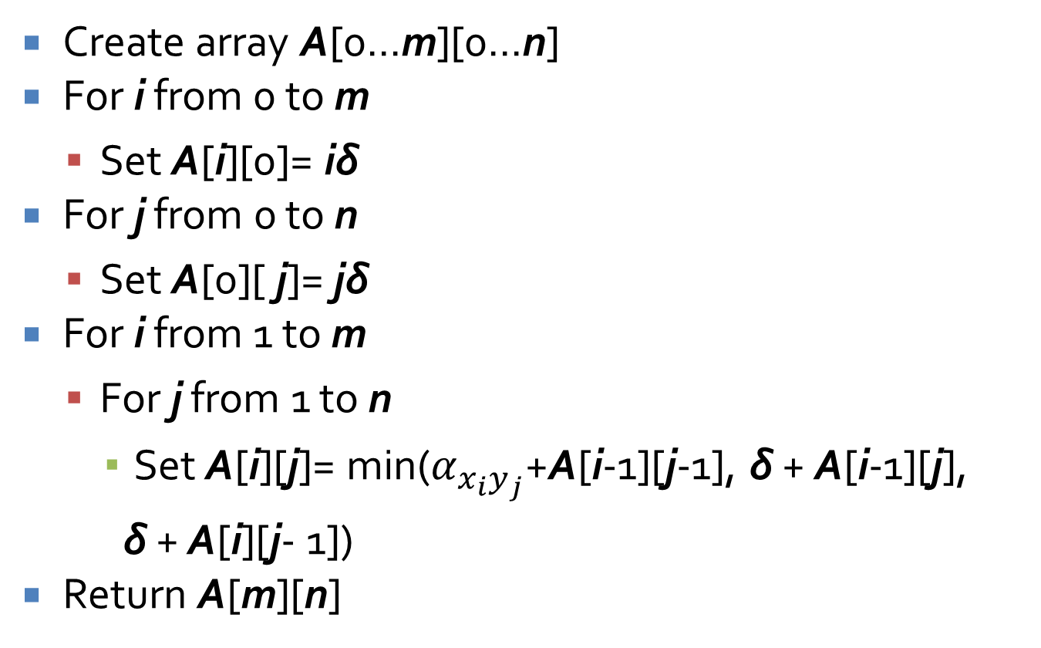
Alignment(X,Y)
Create array A[0...m][0...n]
For i from 0 to m
  Set A[i][0]= iδ
For j from 0 to n
  Set A[0][ j]= jδ
For i from 1 to m
  For j from 1 to n
    Set A[i][j]= min($α_{x_{i}y_{j}}$+A[i-1][j-1], δ + A[i-1][j],
    δ + A[i][j- 1])
Return A[m][n]

Slide 46
Table A of OPT values
0 | 0 | δ | 2δ | … | (j -1)δ | jδ | … | nδ
1 | δ
2 | 2δ
 | …
i – 1 | (i-1)δ
i | iδ
 | …
m | mδ
 | 0 | 1 | 2 | … | j - 1 | j | … | n

Slide 47
Sequence alignment example
Find the minimum cost to align:
  "garbage"
  "ravaged"
The cost of an insertion (or deletion) δ is 1
The cost of replacing any letter with another letter is 1
The cost of "replacing" any letter with itself is 0

Slide 48
Fill in the table
 |  | g | a | r | b | a | g | e
 | 0 | 1 | 2 | 3 | 4 | 5 | 6 | 7
r | 1
a | 2
v | 3
a | 4
g | 5
e | 6
d | 7

Slide 49
Maximum Flow

Slide 50
Flow networks
A flow network is a weighted, directed graph with positive edge weights
  Think of the weights as capacities, representing the maximum units that can flow across an edge
  It has a source s (where everything comes from)
  And a sink t (where everything goes to)
Some books refer to this kind of flow network specifically as an st-flow network

Slide 51
Maximum flow
A common flow problem is to find the maximum flow
A maximum flow is a flow such that the amount leaving s and the amount going into t is as large as possible
In other words:
  The maximum amount of flow gets from s to t
  No edge has more flow than its capacity
  The flow going into every node (except s and t) is equal to the flow going out

Slide 52
Flow network
4
a
b
5
3
3
7
4
7
s
c
d
t
6
1
4
6
e
f
5

Slide 53
Ford-Fulkerson algorithm
Ford-Fulkerson is a family of algorithms for finding the maximum flow
Start with zero flow on all edges
Find an augmenting path (increasing flow on forward edges and decreasing flow on backwards edges)
If you can still find an augmenting path in the residual graph, go back to Step 2

Slide 54
Bipartite Matching

Slide 55
Bipartite graphs
Recall that a bipartite graph is one whose nodes can be divided into two disjoint sets X and Y
Every edge has one end in set X and the other in set Y
  There are no edges from a node inside set X to another node in set X
  There are no edges from a node inside set Y to another in set Y
Equivalently, a graph is bipartite if and only if it contains no odd cycles

Slide 56
Maximum matching
Matching means pairing up nodes in set X with nodes in set Y
A node can only be in one pair
A perfect matching is when every node in set X and every node in set Y is matched
It is not always possible to have a perfect matching
We can still try to find a maximum matching in which as many nodes are matched up as possible

Slide 57
Bipartite matching problem
X
A
B
C
D
E
F
Y
G
H
I
J
K
L

Slide 58
Maximum flow problem
s
X
A
B
C
D
E
F
Y
G
H
I
J
K
L
t

Slide 59
An easy change
Take a bipartite graph G and turn it into a directed graph G'
Create a source node s and a sink node t
Connect directed edges from the source to all the nodes in set X
Connect directed edges from all the nodes in set Y to the sink
Change all the undirected edges from X to Y to directed edges from X to Y
Set the capacities of all edges to 1

Slide 60
Algorithmic changes
We run the Ford-Fulkerson algorithm to find the maximum flow on our new graph
Since all edges from X to Y have capacity 1, they will either have a flow of 1 or of 0
If they have a flow of 1, they are in the matching
If they have a flow of 0, they aren't
The maximum flow value tells us how many nodes are matched

Slide 61
Maximal matching
To make the algorithm go faster, we can start with a maximal matching
A maximal matching is not necessarily maximum, but you can't add edges to it directly without removing other edges
In essence, arbitrarily match unmatched nodes until you can't anymore
Then start the process of looking for augmenting paths

Slide 62
Matching algorithm
Come up with a legal, maximal matching
Take an augmenting path that starts at an unmatched node in X and ends at an unmatched node in Y
If there is such a path, switch all the edges along the path from being in the matching to being out and vice versa
If there is another augmenting path, go back to Step 2

Slide 63
Quiz

Slide 64
Upcoming

Slide 65
Next time…
Exam 3
After that:
  Sequencing problems
  Partitioning problems
  Graph coloring
  Numerical problems
  Co-NP

Slide 66
Reminders
No class Friday!
Work on Assignment 6
Study for Exam 3
  In class on Monday
For next Wednesday, read 8.5, 8.7, 8.8, and 8.9
  Your three-sentence summary should list all of the different NP-complete problems

